Slide 1
OSCE 7/18
NDH A&E

Slide 2
Case 1
M/62, c/o: severe retrosternal chest pain for 30 minutes, radiation to jaw, associated with sweating
BP 135/98 p100, afebrile, SaO2 100% 6L O2
ECG done

Slide 3
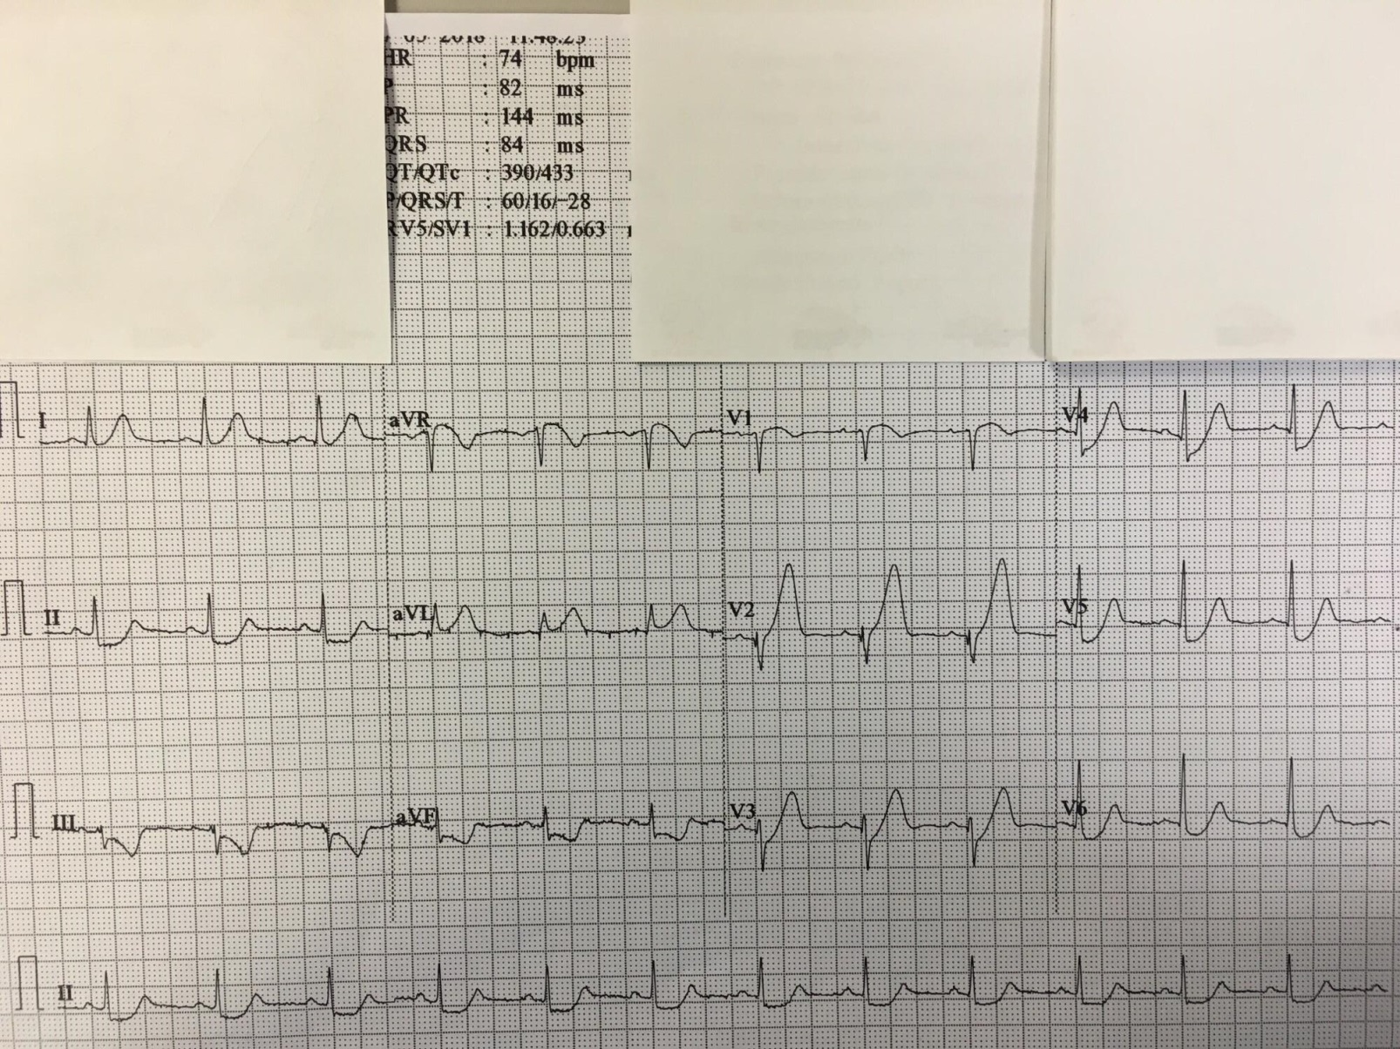
ECG

Slide 4
Questions
1. What are the ECG abnormalities?
2. What is your diagnosis?
3. What is the likely culprit vessel?
4. How would you manage the patient in A&E?
5. What is the definite treatment?

Slide 5
Case 2
M/59, GPH, dizziness/Rt face/limbs weakness since 06:30, arrive A&E 09:33
Exam: GCS 15/15, BP 152/76 p59, Rt side power 0/5, Lt side power full, multi-directional nystagmus, dysphasia with slurred speech

Slide 6
Questions
What is your diagnosis?
What is your immediate management?

Slide 7
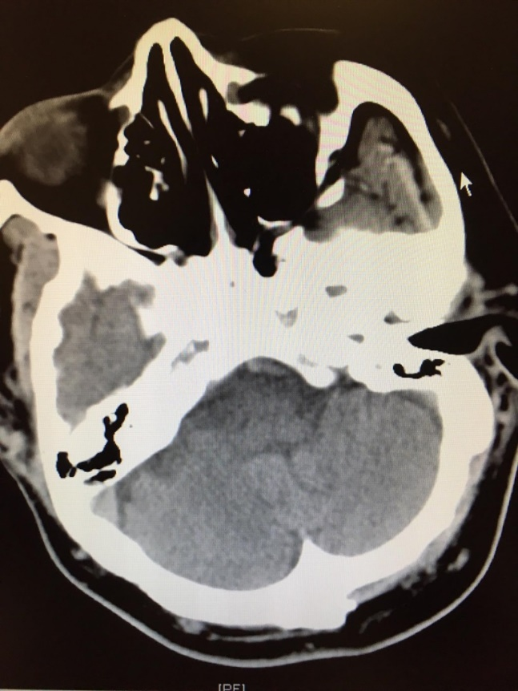
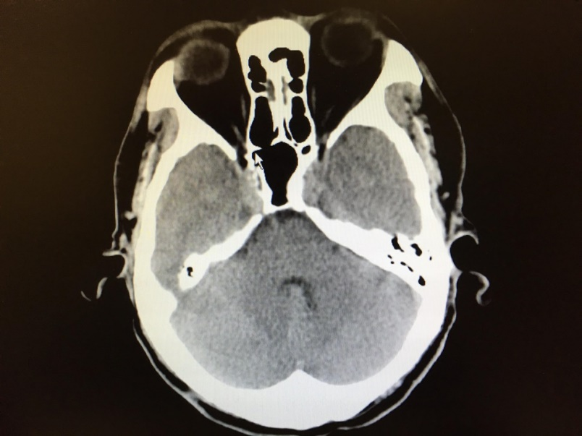
CT brain

Slide 8
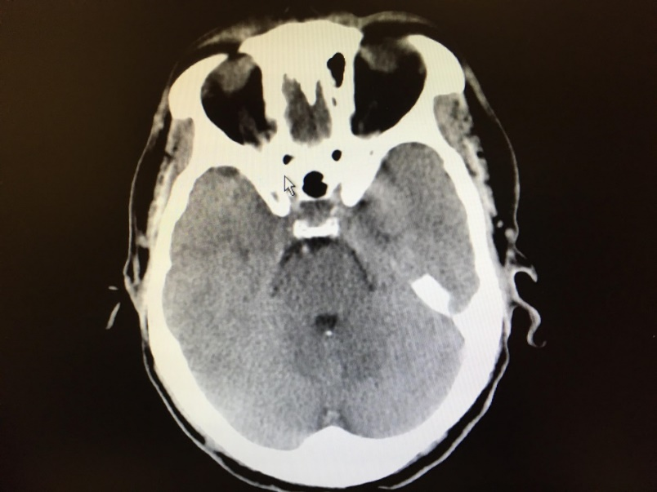
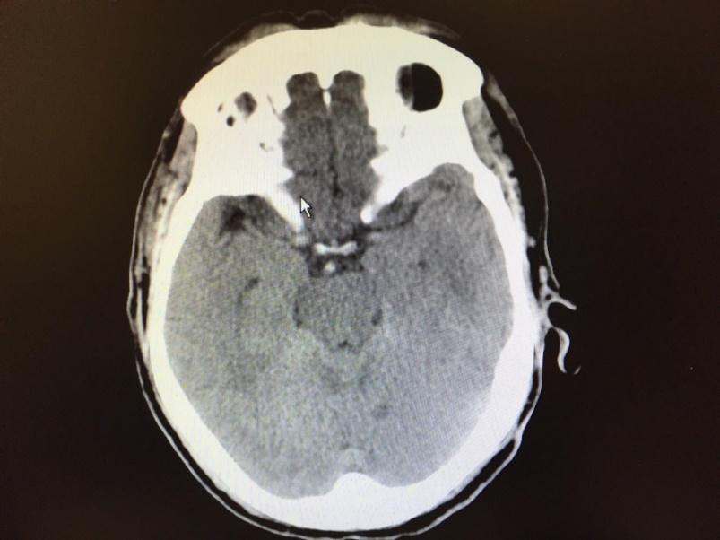
CT brain

Slide 9
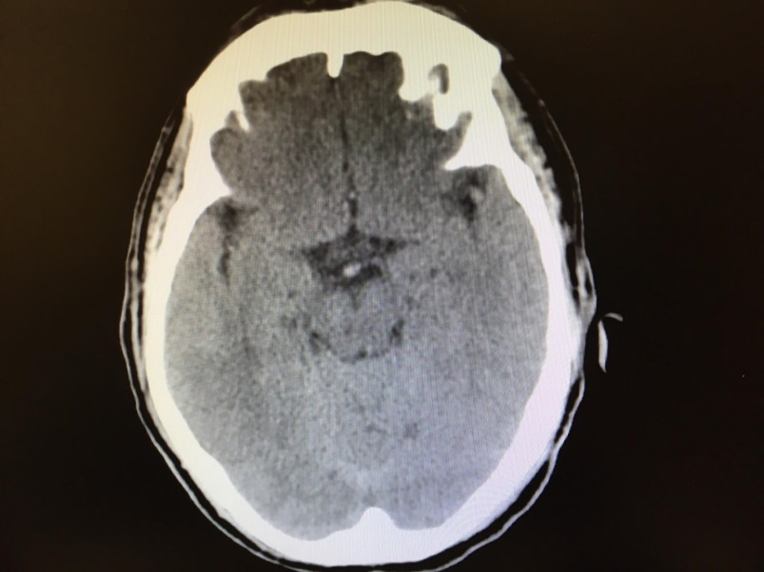
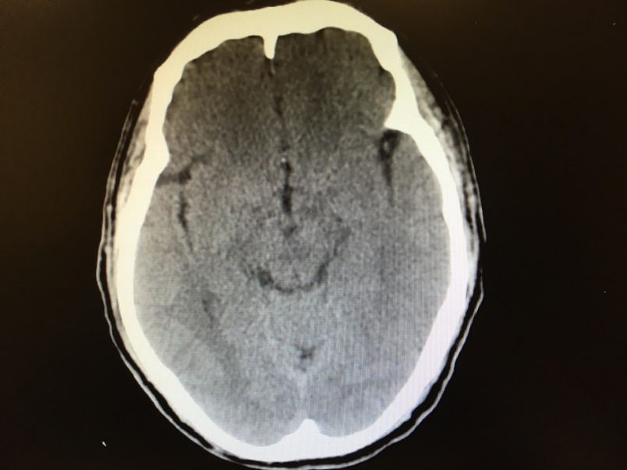
CT brain

Slide 10
Questions
3. Any specific sign in the CT brain?

Slide 11
Progress
IV TPA given ~ 10:32am, with Rt side power improved to 5-/5
Transfer ASU
1 day later, Rt sided power drop to 0/5, left side power turned to 0-1/5 afterwards, eye movement intact, aphasia +
Repeated CT brain showed no hemorrhage, hypodensities over left paramedian pons

Slide 12
Questions
4. What is your diagnosis?
5. Any other clinical conditions present similar to this diagnosis (not in this case)?

Slide 13
Case 3
A 30 years old gentleman suffered from a fish sting (once) at his right hand. He presented with severe right hand pain and swelling in your AED 30 minutes after the injury. The offending fish and his hand were shown below.

Slide 14
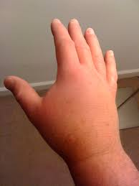
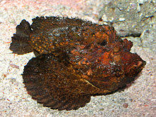
Case 3

Slide 15
Questions
What part of the fish contains the offending poison?
What is the nature of the toxin and what clinical manifestations do you expect?
What is your treatment strategy?
What are the indications for anti-venom?
How would you give the anti-venom?

Slide 16
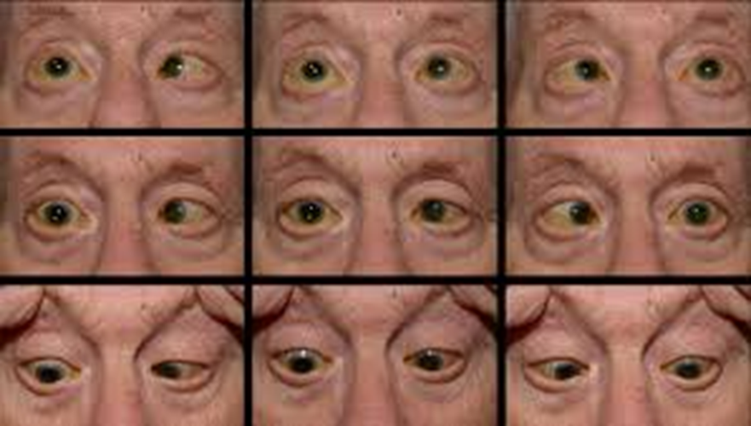
Case 4
M/60, Hx of squamous papilloma of left tongue, c/o: headache for 6 months, diplopia for 1.5 months, exam: GCS 15/15, BP 137/78, no focal neurological sign
Eye exam in following photos

Slide 17
Questions
1. What is the clinical diagnosis?

Slide 18
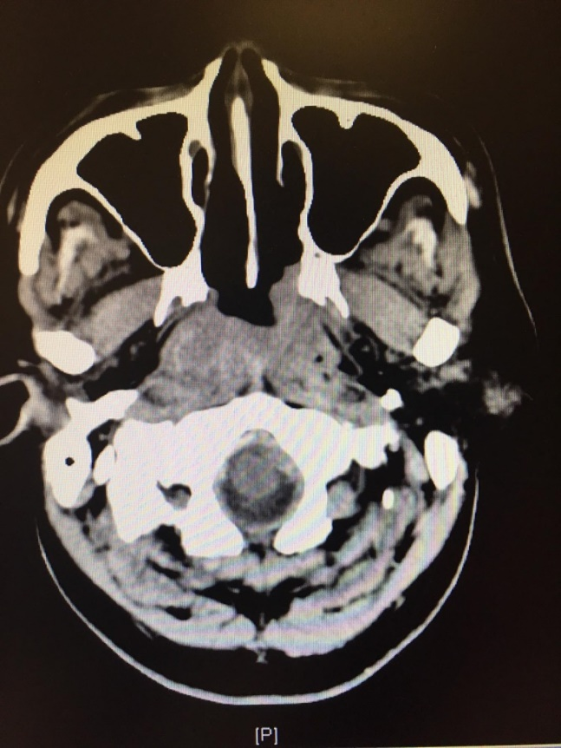
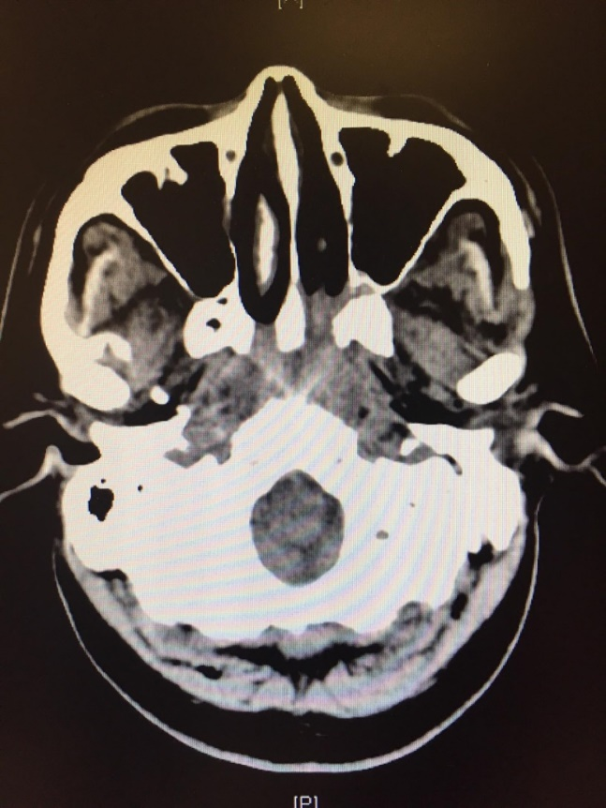
CT brain

Slide 19
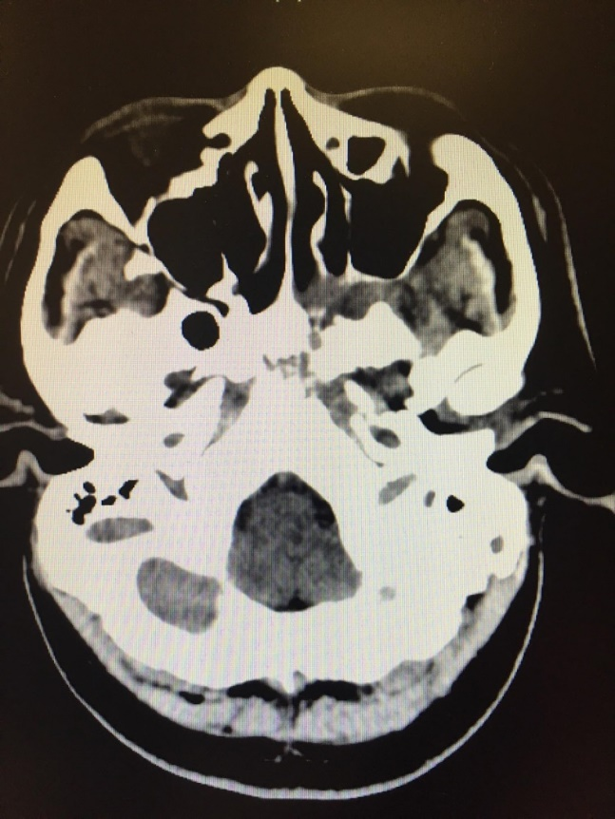
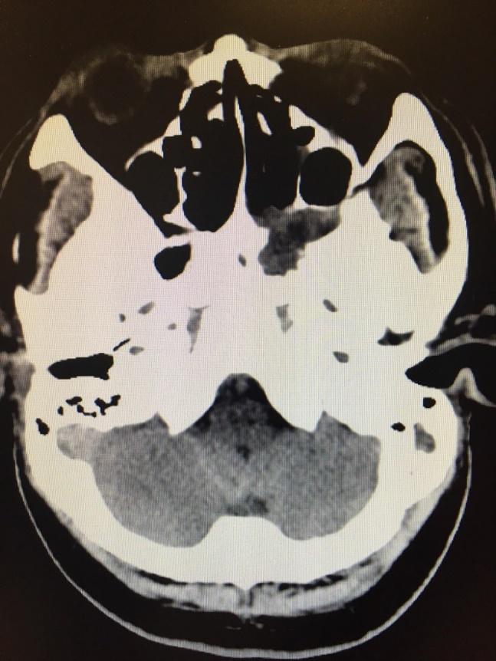
CT brain

Slide 20
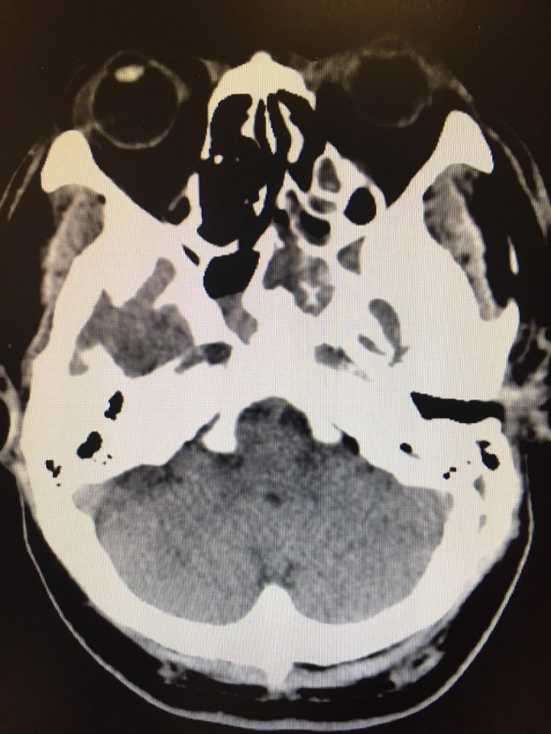
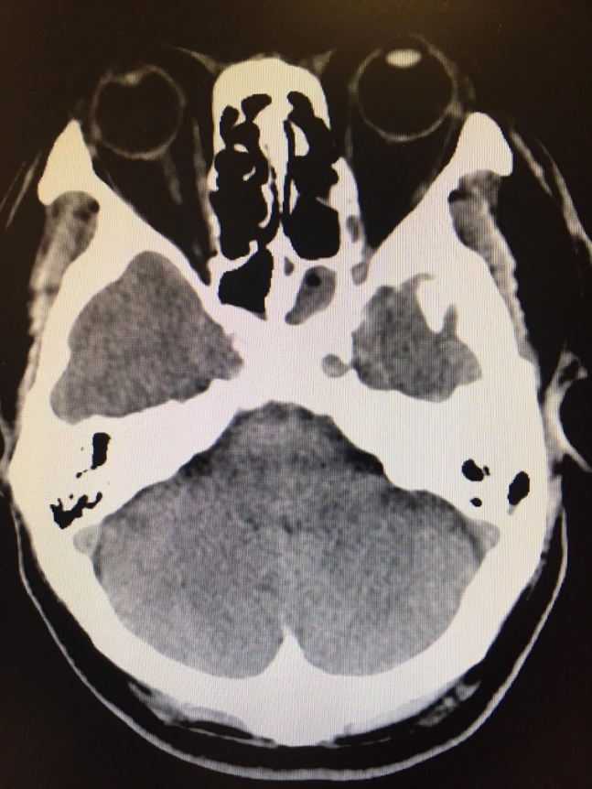
CT brain

Slide 21
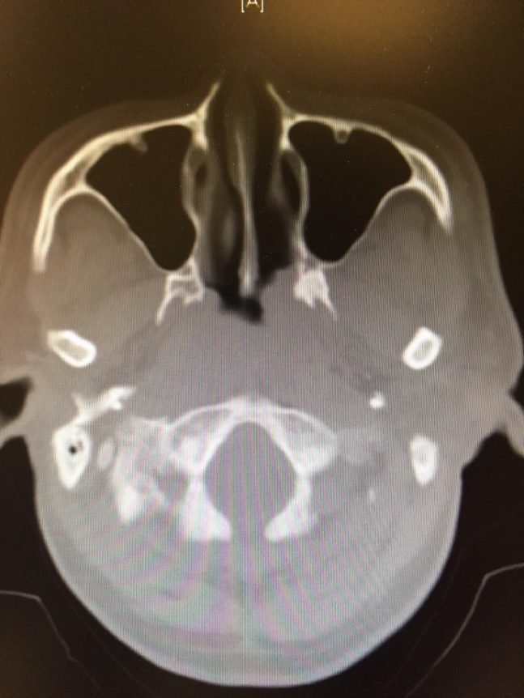
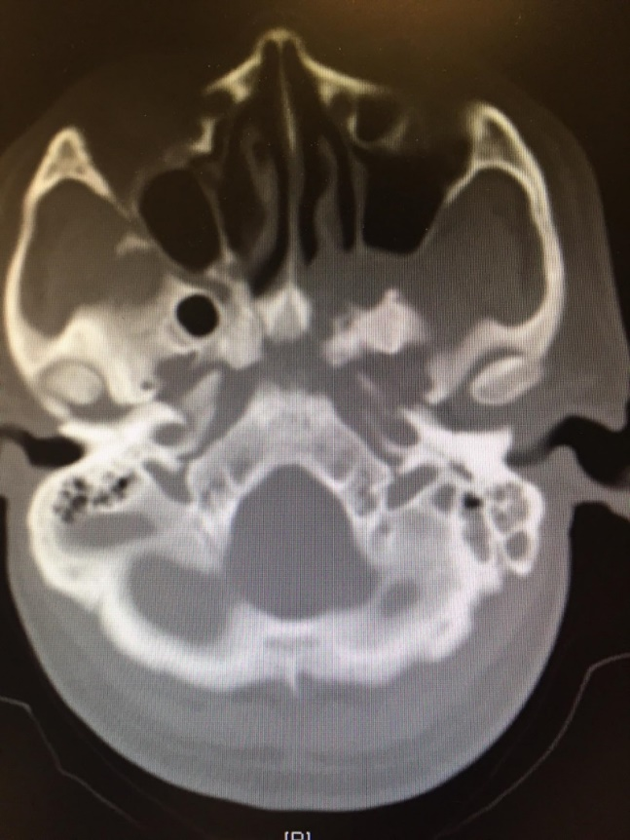
CT bone window

Slide 22
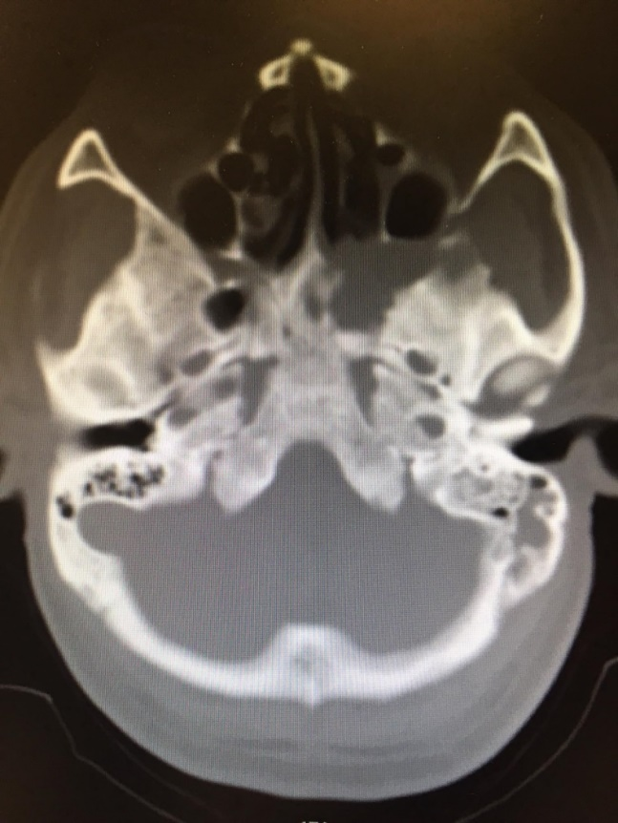
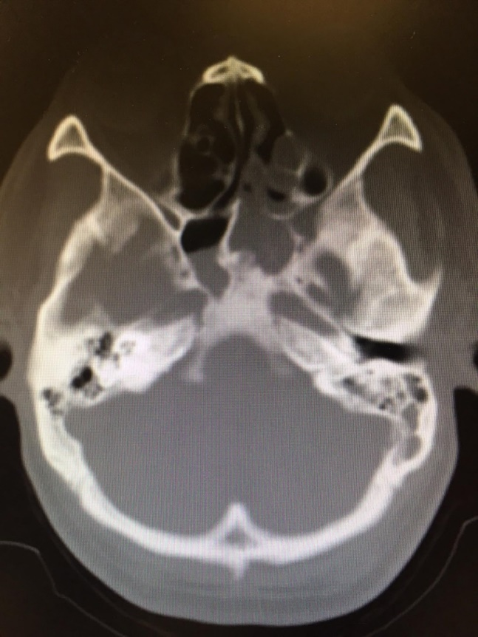
CT bone window

Slide 23
Questions
2. What are the CT brain abnormalities?
3. What is the most likely diagnosis?
4. What investigations will you order?

Slide 24
END

